Slide 1

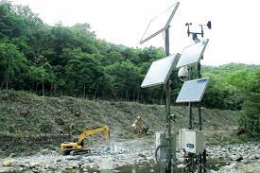
FLOOD MONITORING AND EARLY WARNING
Presented by :
K.S.Eniya Varshini
N. Deepitha
M. Srinithi
S. Menaka
S. Elakkiya

Slide 2
Contents
DEFINITION
WHY FLOOD MONITORING?
SOURCES OF FLOOD MONITORING
EFFECTS
CONCLUSION

Slide 3
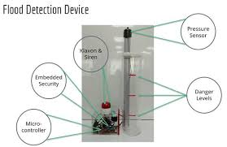
Definition:
Observing and analyzing water levels and weather conditions to detects potential floods.
This information is then used to alert communities in advance, allowing them to take preventive measures and evacuate if necessary.

Slide 4
Why flood monitoring? Flood Monitoring is crucial for early detection and response to potential flooding events. It helps to migrate the impact of floods by providing Flood monitoring timely information on water levels, allowing authorities to issue warnings, evacuate residents, and implement flood control measures. Monitoring also aids in understanding patterns, contributing to better flood prediction and prevention strategies.

Slide 5
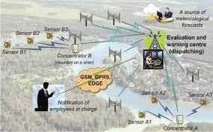
Sources of flood monitoring
Remote sensing satellites capture images to monitor water levels, changes in riverbanks, and flood extent.
Meteorological data helps predict heavy rainfall, a key factor in flooding.
Government agencies monitor and share information on flood risk, response plans and evacuation strategies.
IoT devices, including sensors on infrastructure like bridges, contribute real-time data on water levels and conditions.

Slide 6
Effects:
It is necessary to design or build a system which will monitor the flood prone area and give alert to the people of that area.
It allow detection and assessment of threating events to take place before it hits a community.
Reducing the risk of casualties during flooding events.
These system raise awereness about flood risks, fostering a culture of preparedness and resilience within communities.

Slide 7
Conclusion: The future of flood monitoring and early warning involves advanced technologies like Satellite imaging, AI, and machine learning to enhance prediction accuracy. Integrated sensor networks and real-time data analysis will play a crucial role in providing timely alerts and improving disaster preparedness. The developed flood monitoring and early warning system that utilizes ultrasonic sensor to detect water level. It successfully passed several tests based on the different parameters.

